Slide 1
Mistaken Identity
Sikhs in America

Slide 2
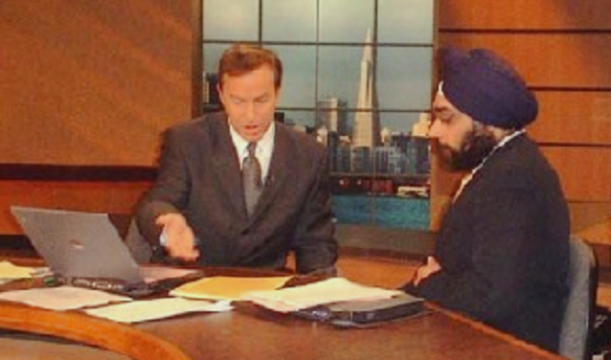
Sikhs in America Life
First Doc to reach Ground Zero on 9/11
Dr. Nijher with David Cruz of KNBC 9/6/02

Slide 3
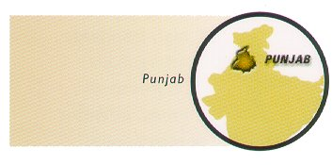
Twenty-two million Sikhs worldwide trace the origin of their religion to Punjab.

Slide 4
In Yuba-Sutter County, Sikh farmers account for:
95% of the peach farming
60% prune farming
20% almonds & walnut
In the Bakersfield & Fresno area 20% of the table grapes are grown by Sikh farmers.

Slide 5
Sikhism is the fifth largest religion in the world.

Slide 6
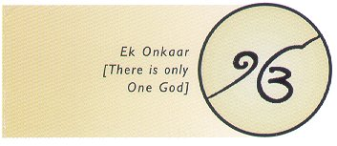
Introduction to Sikhism
Sikhism, the youngest of the world religions, is barely five hundred years old. Its founder, Guru Nanak, was born in 1469. Guru Nanak spread a simple message of “Ek Ong Kar”: we are all one, created by the One Creator of all Creation.

Slide 7
The word Sikh means disciple or student.

Slide 8
Sikhism is a way of life that advocates the practice of holistic life experiences – work, worship, and service.

Slide 9
Teachings of Sikhism
Acceptance of all religions –
Sikhism is not opposed to other faiths. The Gurus never claimed Sikhism as the only way to God and salvation.

Slide 10
Teachings of Sikhism
Equality for women –
Sikhs believe that women and men should have equal rights and privileges.

Slide 11
Teachings of Sikhism
Equality for all humankind –
Sikhs believe that everyone is equal, regardless of their ethnic, racial, or religious origin or beliefs.

Slide 12
Guru Gobind Singh-the tenth and final human Sikh Guru-revealed a new, voluntary order of the Sikhs, called the Khalsa (meaning “belonging only to the Divine”).

Slide 13
Articles of Sikh Faith (symbols) or 5 K’S
Kesh-uncut hair
Comb to keep hair clean
Kirpan-(sword) symbol of self defense and protection of human rights
Kara-bracelet-to remind you the omnipotent existence of almighty God
Katch (underwear) modesty and self restrain

Slide 14
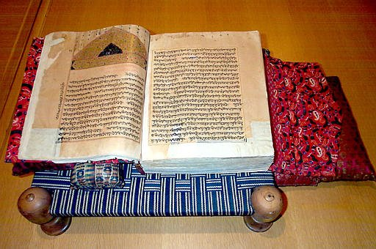
Guru Granth Sahib is the eternal spiritual guide of the Sikhs.

Slide 15
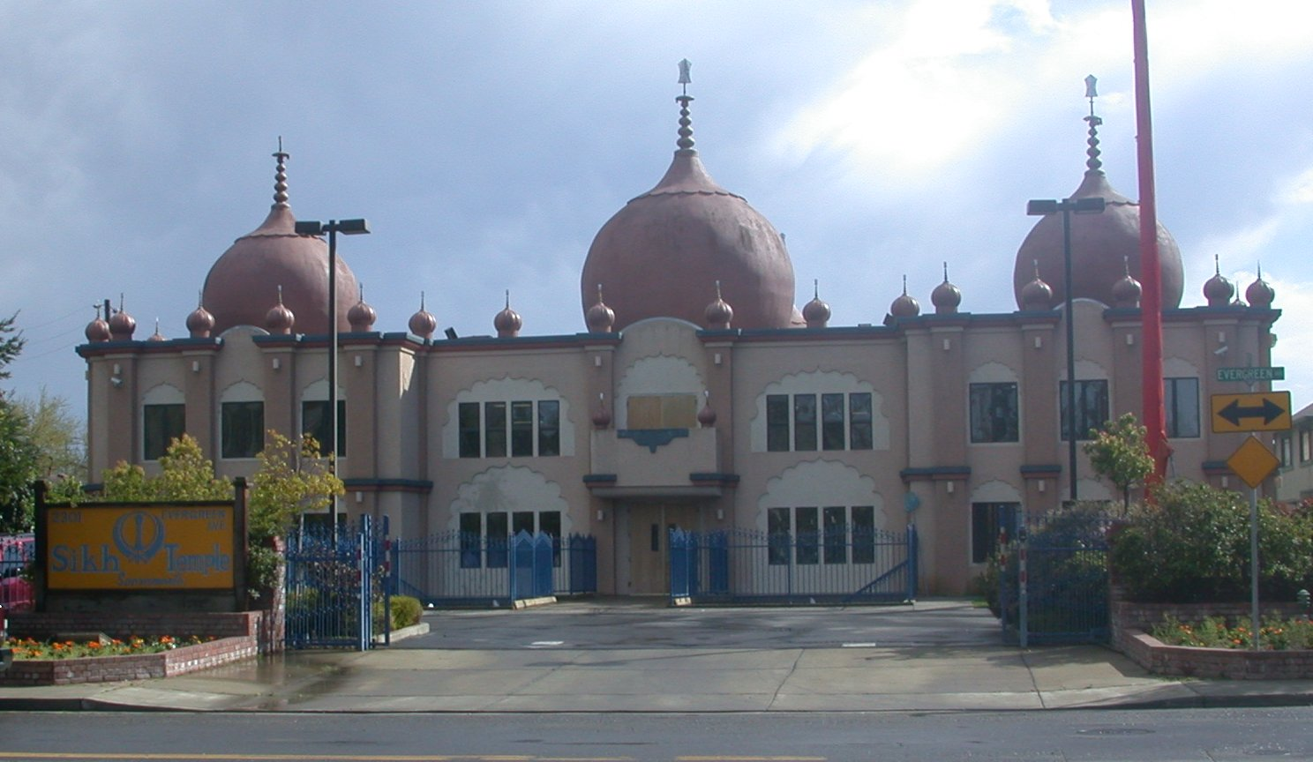
Sikh Temple West Sacramento

Slide 16
99% of the people who wear turbins in America are Sikh.

Slide 17

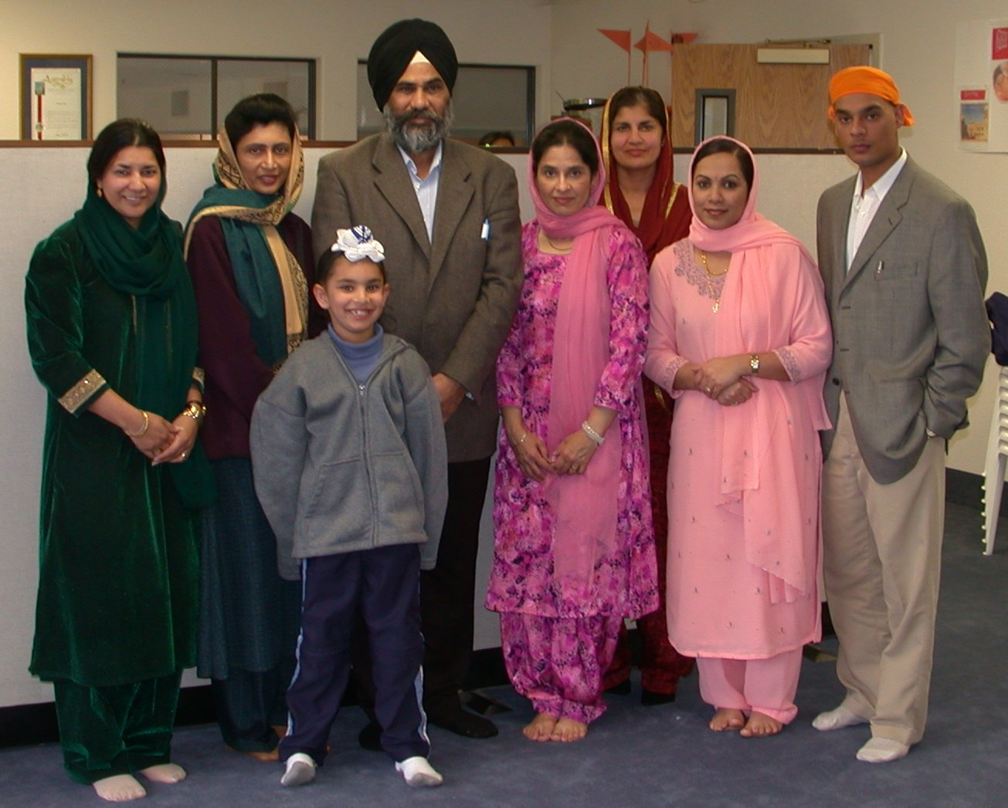
Sunday School Teachers

Slide 18
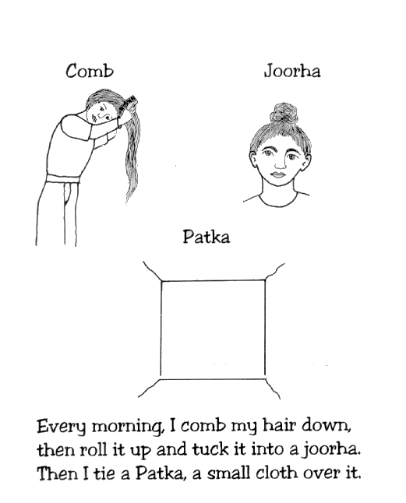

Slide 19
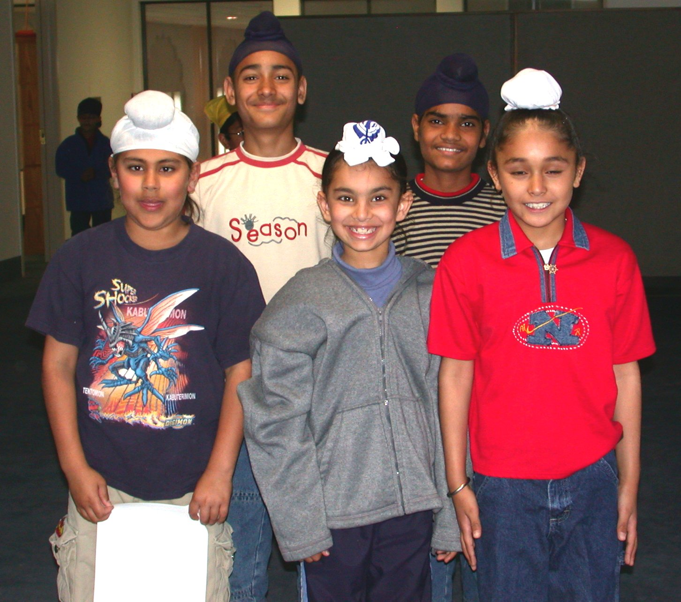

Slide 20
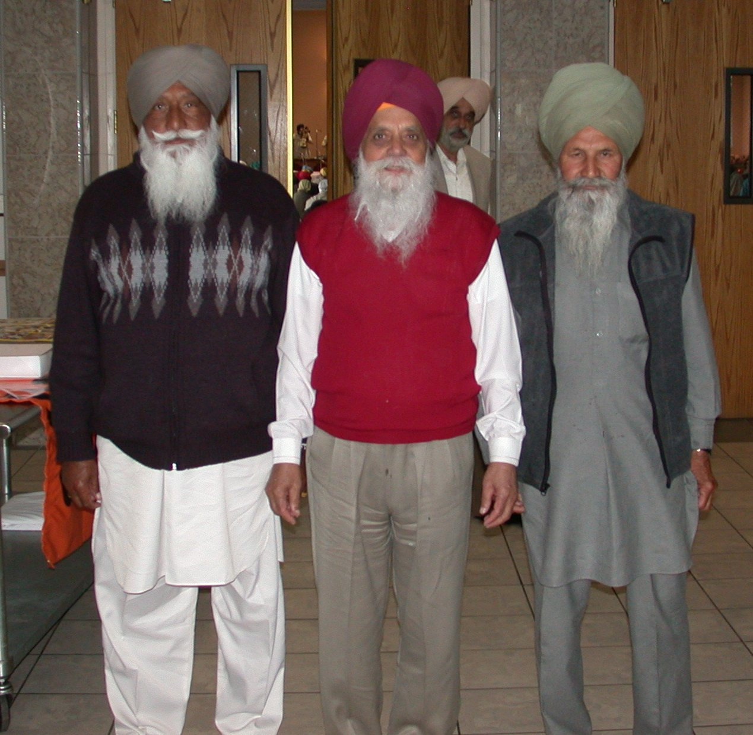

Slide 21
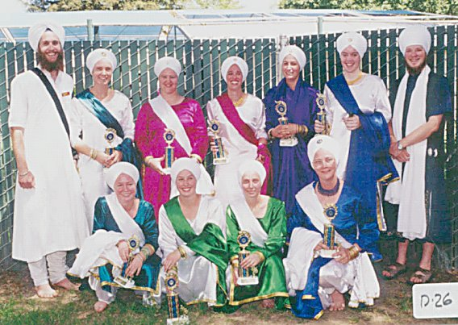

Slide 22
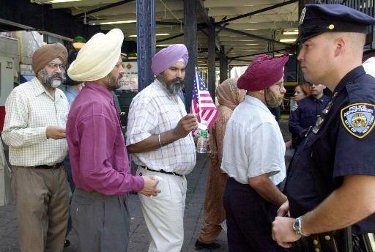

Slide 23
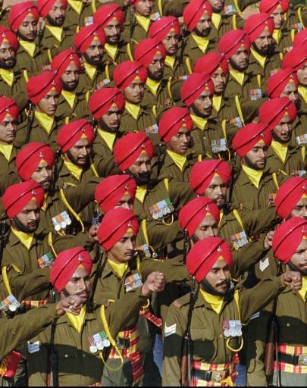

Slide 24
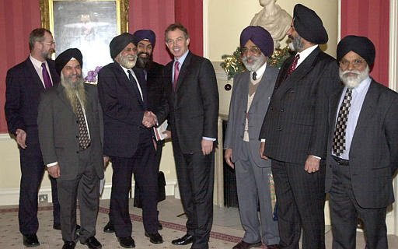
Sikhs Meet British Prime Minister Tony Blair

Slide 25
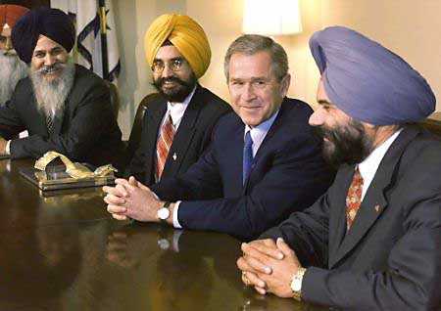
Sikhs Meet President Bush

